Slide 1

STOCK MARKET DATA ANALYSIS
By Pallavi Roy

Slide 2
Table of Contents
1
2
4
5
3
OBJECTIVES
SNAP-SHOT OF RAW DATA
DATA DICTIONARY
The Purpose/Questions based on which the analysis has been performed
Displays the row data
Provide brief description of the dataset
DATA ANALYSIS
INSIGHTS
Queries and output based on the objectives
Visions and actions based on the analysis

Slide 3
OBJECTIVES
Total no. of sectors
Sector-wise most expensive stocks
Average price-per-earnings sector-wise
Value perspective based on price-per-earnings
Analysis of stocks based on dividend yield
Stocks with negative net income
Industries to look at while buying
Companies with more assets over liabilities

Slide 4
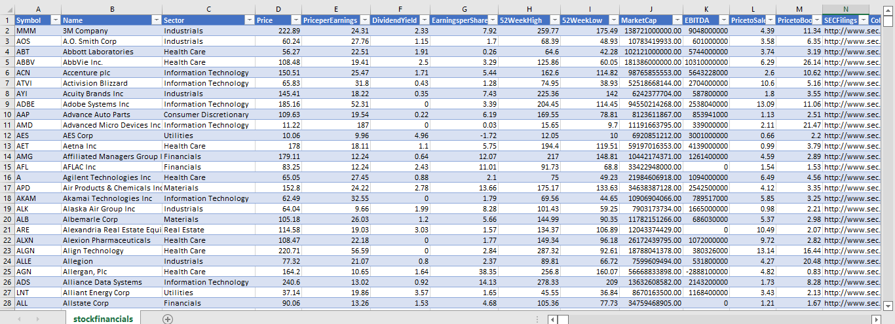
SNAP-SHOT OF RAW DATA
Source: https://datahub.io/core/s-and-p-500-companies-financials#data

Slide 5
Data Dictionary
Name – Name of the company
Sector- Industry the company belongs to
Price - Price of the stock at the time data had been collected
Price Per Earnings - Ratio of share price of a stock to its earnings per share (EPS)
Earnings Per Share – A company's net profit divided by the number of common shares it has outstanding
Dividend Yield - The percentage of a company's share price that it pays out in dividend each year
52 Week High/Low - The highest and lowest price at which a stock has been traded during the time period
Market Cap – The total dollar market value of a company's outstanding shares of stock
Price to Sales - Ratio of market capitalization and annual revenue of a company
Price to Book - Ratio of the market price per share divided by the book value per share

Slide 6
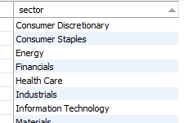
Data Analysis
Q. What is the total no. of sectors present in the dataset –
Total 11 exclusive sectors are present in the given dataset namely –
Consumer Discretionary,
Consumer Staples, Energy, Financials,
Health Care, Industrials,
Information Technology, Materials,
Real Estate, Telecommunication
Services, Utilities.
Query Executed:
select distinct sector from stockfinancials order by sector;

Slide 7
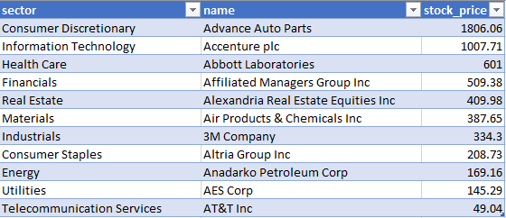
Data Analysis
Q. Sector-wise most expensive stocks
Query Executed:
select sector, name, max(price) as stock_price from stockfinancials group by sector order by max(price) desc;

Slide 8
Data Analysis
Q. Average price-per-earnings sector-wise
High P/E indicates future growth potential
Low P/E indicates weak current and future performance
Query Executed:
select sector, round(avg(priceperearnings),2) as AvgPricePerEarnings from stockfinancials group by sector;

Slide 9
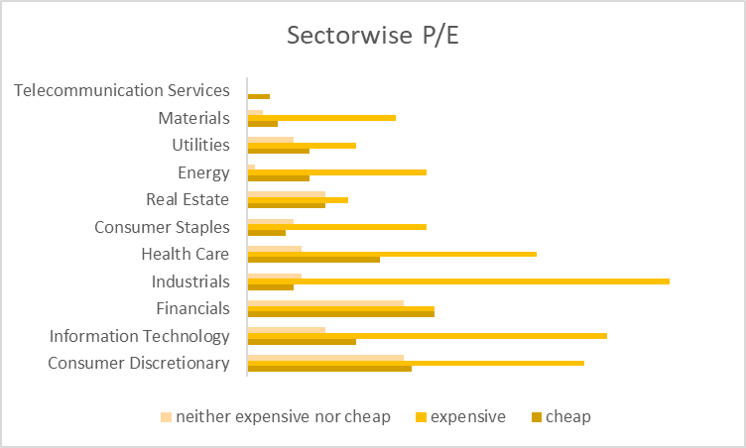
Data Analysis
Q. Value perspective based on price-per-earnings
Expensive stocks belong to industries like Industrials, Information Technology,
Consumer Discretionary
Query Executed:
select name, sector, price, priceperearnings, (case when priceperearnings < 15.00 then "cheap" when priceperearnings between 15.00 and 18.00 then "neither expensive nor cheap" else "expensive" end) as ValuePerspective from stockfinancials order by sector, priceperearnings desc;

Slide 10
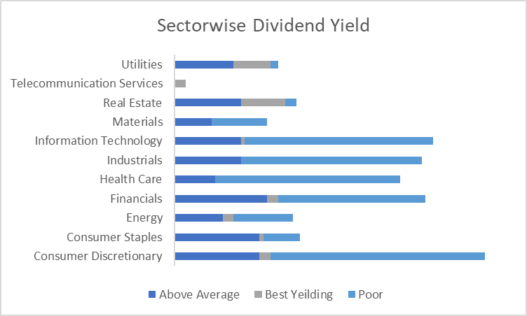
Data Analysis
Q. Analysis of stocks based on dividend yield
Industries with high dividend yield are –
Real Estate, Utilities and Telecommunication services
Query Executed:
select sector, name, price, dividendyield, (case when dividendyield between 2.00 and 4.00 then "Above Average" when dividendyield > 4.00 then "Best Yeilding" else "Poor" end) as ValuePerspective from stockfinancials order by sector, dividendyield desc;

Slide 11
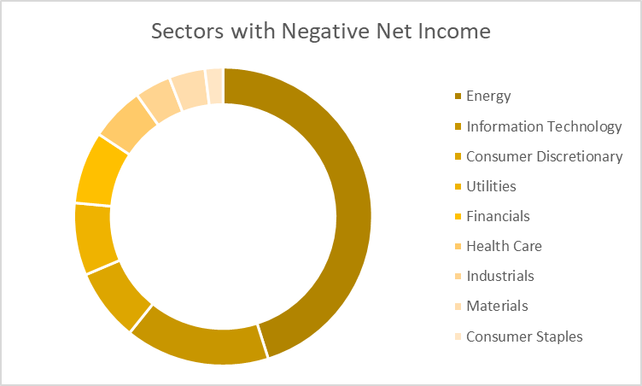
Data Analysis
Q. Stocks with negative net income
Negative EPS refers to fundamentally weaker companies
Query Executed:
select sector, name, earningspershare from stockfinancials where earningspershare < 0.00
order by sector, earningspershare;

Slide 12
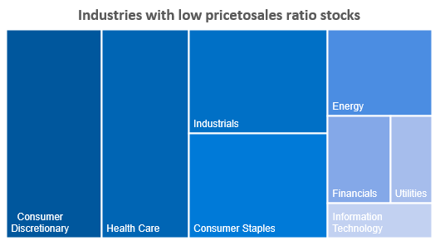
Data Analysis
Q. Industries to look at while buying
P/S ratio refers to no of years a company’s sales will be taking to reach its market capitalisation. Hence the lower the better.
Query Executed:
select name, sector, pricetosales from stockfinancials where pricetosales < 1order by pricetosales;

Slide 13
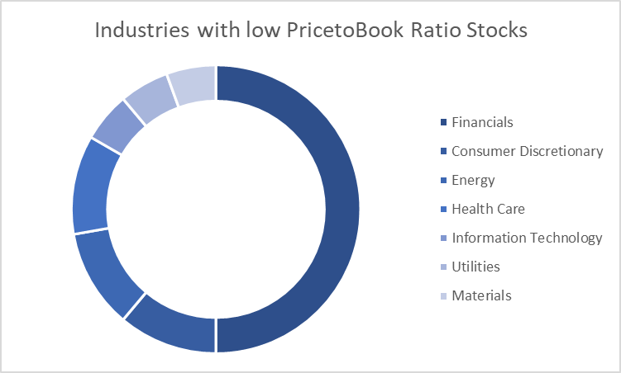
Data Analysis
Q. Companies with more assets over liabilities
Low P/B ratio refers to stocks which are undervalued
Query Executed:
select sector, name, pricetobook, if(pricetobook<1.00,"undervalued","overvalued") as ValuationPerspective from stockfinancials order by sector, pricetobook;

Slide 14
INSIGHTS
Advance Auto Parts has the highest and AT&T Inc has the lowest stock price.
Based on the average industry wise P/E ratio, Energy and Information Technology are the industry with very high growth potential in future. However, Telecommunication sector is showing the weakest performance so far.
Investors need to pay high for the stocks belong to industries like industrials, information technology and consumer discretionary. On the contrary, Telecommunication services has the cheapest stocks only.
As companies with high dividend yield can indicate a company in distress hence investors can avoid buying stocks under Real Estate, Utilities and Telecommunication services. Stocks from IT, Health Care, Financials etc. can be chosen as less risky instead.
Investors should stay away from Energy sectors as it has maximum no of companies with negative EPS i.e negative net income referring to those spending more than its earnings.
Industries like Consumer discretionary, Health care and industrials have more stocks with Pricetosales ratio less than 1 hence these stocks should be more preferable as the companies sales will soon reach respective market cap value.
Count of financial stocks with low P/B ratio are highest. Investing in this industry is considered to be solid as they are trading at a low price and have moderate future growth potential.

Slide 15

THANK YOU

